Slide 1
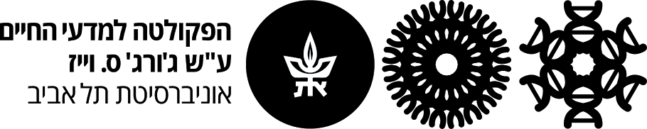
Mutation Analysis Workshop
Adva Yeheskel
The Bioinformatics Unit
Tel Aviv University
April 10th 2016

Slide 2
Will the nonsynonymous SNP damage the protein?
promotor
exon
intron
intron
exon
rSNP
(regulatory SNP)
sSNP
(synonymous)
Silent mutation
cSNP
(non-synonymous)
Missense mutation
Amino acid substitution!
iSNP
(intron SNP)

Slide 3
Sequence variants nomenclature
c.76A>C
  denotes that at nucleotide 76 an A is changed to a C
c.76_78del
  denotes a deletion from nucleotides 76 to 78
p.Lys2_Met3insGlnSerLys
  denotes that the sequence GlnSerLys (QSK) was inserted between amino acids Lysine-2 (Lys, K) and Methionine-3 (Met, M), changing MKMGHQQQCC to MKQSKMGHQQQCC
Human Genome Variation Society (HGVS) recommendations

Slide 4
Example: MED25 c.116A>G p.Tyr39Cys
Find out what is the genomic location (chromosome / location / variant allele ):
Chr 19 / 50321714 / 116 A>G
(New assembly: 49818457)
Uniprot webpage: http://www.uniprot.org/uniprot/Q71SY5
*You are welcome to use your own example!

Slide 5
Identify mutation position in NCBI mRNA
>NM_030973.3
atttctgctcattccgcggcgtcggctgcggctgcagtggtggtggcggg taccgcacggggtatggtccccgggtccgagggcccggcccgcgccggga gcgtggtggccgacgtggtgtttgtgattgagggtacggccaacctggga ccctacttcgaggggctccgcaagcactacctgctcccggccatcgagta ttttaatggtggtcctcctgctgagacggacttcgggggagactatgggg ggacccagtacagcctcgtggtgttcaacacagtggactgcgctcccgag tcctacgtacaatgtcacgctcccaccagcagcgcctatgagtttgtcac ctggctcgatggcattaagttcatgggcgggggtggtgagagctgcagcc tcatcgcggaaggactcagcacagccttgcagctgtttgatgacttcaag aagatgcgcgagcagattggccagacgcaccgggtctgcctcctcatctg caactcacccccatacttgttgcctgctgttgagagcaccacgtactctg gatgcacaactgagaatcttgtgcagcagattggggagcgggggatccac ttctccattgtgtctccccggaagctgcctgcgcttcggcttctgtttga…
NCBI mRNA

Slide 6
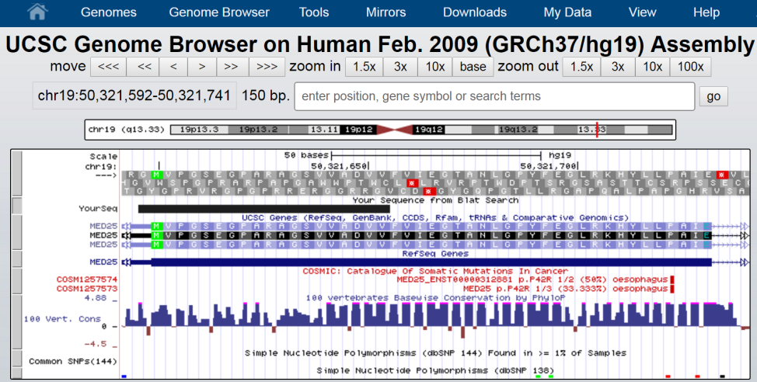
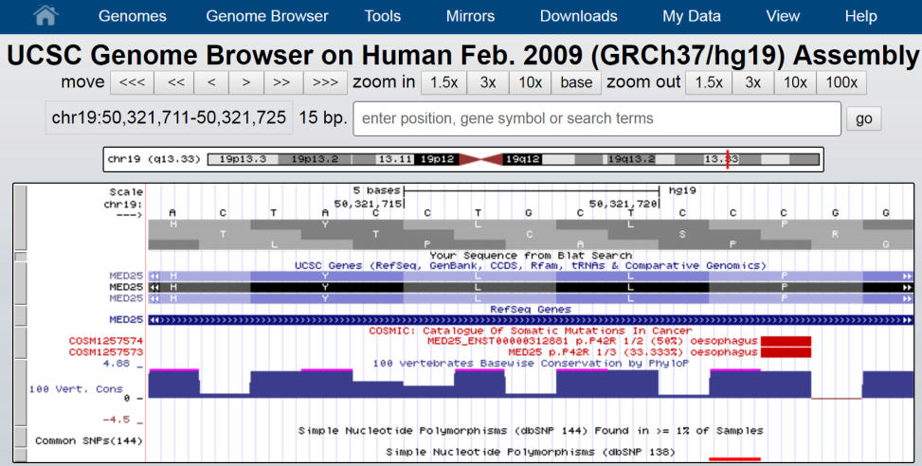
Identify mutation position in UCSC genome browser
Genome Browser

Slide 7
MED25 protein sequence
>sp|Q71SY5|MED25_HUMAN MVPGSEGPARAGSVVADVVFVIEGTANLGPYFEGLRKHYLLPAIEYFNGGPPAETDFGGD YGGTQYSLVVFNTVDCAPESYVQCHAPTSSAYEFVTWLDGIKFMGGGGESCSLIAEGLST ALQLFDDFKKMREQIGQTHRVCLLICNSPPYLLPAVESTTYSGCTTENLVQQIGERGIHF SIVSPRKLPALRLLFEKAAPPALLEPLQPPTDVSQDPRHMVLVRGLVLPVGGGSAPGPLQ SKQPVPLPPAAPSGATLSAAPQQPLPPVPPQYQVPGNLSAAQVAAQNAVEAAKNQKAGLG PRFSPITPLQQAAPGVGPPFSQAPAPQLPPGPPGAPKPPPASQPSLVSTVAPGSGLAPTA QPGAPSMAGTVAPGGVSGPSPAQLGAPALGGQQSVSNKLLAWSGVLEWQEKPKPASVDAN TKLTRSLPCQVYVNHGENLKTEQWPQKLIMQLIPQQLLTTLGPLFRNSRMVQFHFTNKDL ESLKGLYRIMGNGFAGCVHFPHTAPCEVRVLMLLYSSKKKIFMGLIPYDQSGFVNGIRQV ITNHKQVQQQKLEQQQRGMGGQQAPPGLGPILEDQARPSQNLLQLRPPQPQPQGTVGASG ATGQPQPQGTAQPPPGAPQGPPGAASGPPPPGPILRPQNPGANPQLRSLLLNPPPPQTGV PPPQASLHHLQPPGAPALLPPPHQGLGQPQLGPPLLHPPPAQSWPAQLPPRAPLPGQMLL SGGPRGPVPQPGLQPSVMEDDILMDLI
MED25 in Uniprot

Slide 8
Methods for mutation analysis
Sequence based methods
  SNPdryad (2014)
  SIFT + PROVEAN (2012)
  PolyPHEN-2 (2010)
  SNAP2 (2015)
  INPS (2015)
  Mutation assessor (2011)
  Condel – combines MutationAssessor and FatHMM (2011)
Structure based methods
  ENCoM (2014)
  mCSM (2014)
  SDM (2011)
  DUET- combines mCSM and SDM (2014)
  NeEMO (2014)

Slide 9
What most predictors do?
Collect homologs, align them and check conservation of the query position.
Learn from known deleterious mutations in other proteins.
They do not model the mutant!

Slide 10
SNPdryad algorithm
Given a nsSNP input:
SNPdryad extracts the input-nsSNP-containing protein sequence as well as its orthologous sequences from mammals (computed by Inparanoid).
MUSCLE alignment program is used to align the sequences.
PhyML is used to build a phylogenetic tree from the sequence alignment profile.
SNPdryad builds features from the input-nsSNP-containing column of the alignment profile and the phylogenetic tree.
SNPdryad inputs the features into the Random Forest model (trianed on HumDiv) and get the deleterious prediction score (DPS) for the input nsSNP.
Article
Click to run

Slide 11
SNAP2
SNAP2 is a neural network based classifier.
SNAP2 was trained on ~100.000 variants from OMIM, PMD (protein mutant database), HumVar and a set of pseudo-neutral variants based on the EC numbers
The effect of substitution in each position is calculated based on secondary structure, solvent accessibility, disorder, alignments of related sequences and more, taken from the PredictProtein server.
In case of orphan sequences (no homologs) a different algorithm is used (without alignment) and the accuracy is reduced.
SNAP2 is not limited to human variants
Article
Click to run

Slide 12
SIFT + PROVEAN
SIFT prediction is based on the degree of conservation of amino acid residues in sequence alignments derived from closely related sequences, collected through PSI-BLAST.
PROVEAN is a new prediction tool which works for both SNPs and indels.
Article
Click to run

Slide 13
Mutation assessor
The functional impact is assessed based on evolutionary conservation of the affected amino acid in protein homologs. The method has been validated on a large set (60k) of disease associated (OMIM) and polymorphic variants.
The server maps each variant to both Uniprot and Refseq (NCBI) protein sequences (if possible). If the reference residue in the Uniprot protein sequence is different from the one indicated in your variant the analysis will not be performed. For non-human variants please use Uniprot IDs as mapping to Refseq is not supported.
Uniprot IDs are used to extract information about domain boundaries (Pfam, Uniprot), annotated functional regions (Uniprot), protein-protein interactions (Piana). Refseq protein IDs are used to extract known alterations in cancer (COSMIC), SNPs (dbSNP) and known role in cancer (CancerGenes).
The server determines domain boundaries (using Pfam or Uniprot) for the region with the variant and builds multiple sequence alignment using all Uniprot protein sequences or uses existing one from the repository.
Tested on COSMIC mutations.
Article
Click to run
Notes:
It shows lots of information but the score is based only on sequence conservation and specificity which is conservation within the subfamilies in the alignment.

Slide 14
Polyphen-2
For a given amino acid substitution in a protein, PolyPhen-2 extracts various sequence and structure-based features of the substitution site and feeds them to a probabilistic classifier.
PolyPhen-2 tries to identify a query protein as an entry in the human proteins subset of UniProtKB/Swiss-Prot database.
PolyPhen-2 checks if the amino acid replacement occurs at a site which is annotated as:
  DISULFID, CROSSLNK bond or BINDING, ACT_SITE, LIPID, METAL, SITE, MOD_RES, CARBOHYD, NON_STD site
At a later stage if the search for a homologous protein with known 3D structure is successful, it is checked whether the substitution site is in spatial contact with these critical for protein function residues.
PolyPhen-2 identifies homologues of the input sequences via BLAST search in the UniRef100 database.
PolyPhen-2 uses DSSP (Dictionary of Secondary Structure in Proteins) database to get the following structural parameters for the mapped amino acid residues:
  Secondary structure, Solvent accessible surface area, Phi-psi dihedral angles.
Article
Click to run

Slide 15
Condel
Condel stands for CONsensus DELeteriousness score of non-synonymous single nucleotide variants (SNVs). It integrates the output of computational tools aimed at assessing the impact of non synonymous SNVs on protein function.
The Condel score now consists in a weighted average of the scores of MutationAssessor and FatHMM. After exhaustive search of all possible combinations of weighted scores of SIFT, PolyPhen2, MutationAssessor and FatHMM
Running instructions:
  After signing in, write the swissprot id, amino acid change and some identifier. Our example would be: MED25_HUMAN Y39C S1
Article
Click to run
Notes:
Running instructions:
After signing in, write the swissprot id, amino acid change and some identifier. Our example would be: MED25_HUMAN Y39C S1

Slide 16
INPS
INPS is based on SVM regression and it is trained to predict the thermodynamic free energy change upon single-point variations in protein sequences.
It was trained on a dataset which comprises 2648 single-point variations in 132 different globular proteins.
The descriptors include evolutionary information as well as hydrophobicity, mutability and molecular weight.
INPS relies on MSA. When the number of aligned sequences falls below 100, the performance is lower than expected.
Article
Click to run
Notes:
INPS relies on MSA. When the number of aligned sequences falls below 100, the performance is lower than expected.

Slide 17
ENCOM
ENCoM is a coarse grained normal modes analysis method to evaluate thermostability of proteins. The ENCoM Server can be used by anyone to evaluate the effect of mutations on the stability of a structure.
While other methods are based on machine learning or enthalpic considerations, the use of ENCoM, based on vibrational normal modes, is based on entropic considerations
ENCoM is the first coarse-grained normal-mode analysis method that permits to take in consideration the specific sequence of the protein in addition to the geometry
Article
Click to run

Slide 18
mCSM
This server is structure based. It predicts protein stability change upon mutation as well as protein-protein or protein-DNA affinity changes upon mutation.
For a given mutation mCSM defines the atoms within a distance r from its geometric center.
It classifies the atoms to categories: hydrophobic, positive, negative, hydrogen acceptor, hydrogen donor, aromatic, sulphur and neutral. It considers the residue environment only in the wild-type protein structure.
mCSM creates a pharmacophore count vector and calculates the change between wild-type and mutant.
Article
Click to run

Slide 19
SDM (Site Directed Mutator)
the algorithm uses a set of conformationally constrained environment-specific substitution tables to calculate the difference in the stability scores for the folded and unfolded state for the wild-type and mutant protein structures. Based on 371 protein family sequence alignments.
It was validated on 855 mutants from 17 proteins.
Amino acid variations in families of homologous proteins are converted to propensity and substitution tables; these provide quantitative information about the existence of an amino acid in a structural environment and the probability of replacement by any other amino acid.
Article
Click to run

Slide 20
DUET
Combination of SDM and mCSM
ProTherm database
Article
Click to run

Slide 21
NeEMO- Network Enthalpic MOdeling
This is a tool for evaluation of stability changes, based on a neural-network trained on PDBs and a curated version of the ProTherm database (113 proteins, 2399 mutations).
The effective prediction is obtained by means of residue-residue interaction networks, a graph where nodes describe AA as vertices and edges are the chemical and statistical relationships between vertices.
It takes in calculation both 3D data from PDB and MSA. generates a multiple sequence alignment using PSI-BLAST on the UniRef90
It uses TAP, FRST, and QMEAN to estimate the amino acid energy contribution. These tools evaluate statistical potentials such as all atom distance-dependent pairwise, torsion angle, and solvation potentials.
Article
Click to run

Slide 22
Training datasets
HumVar
SNAP2
PolyPhen
HumDiv
SNPdryad
Polyphen
ProTherm
INPS
NeEMO
HOMSTRAD
UniProt humsavar
DUET
mCSM*
SDM
PROVEAN
22196 deleterious, 21119 neutral mutations/ 9679 human proteins
5564 deleterious, 7539 neutral mutations/ 978 human proteins
2648 mutations/131 globular proteins
371 proteins with known structures
20821 disease variants and 36825 polymorphisms
Notes:
mCSM was trained on more datasets and not ProTherm only.

Slide 23
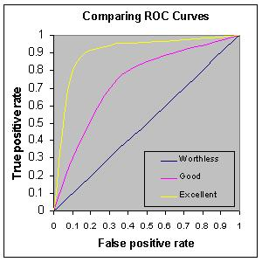
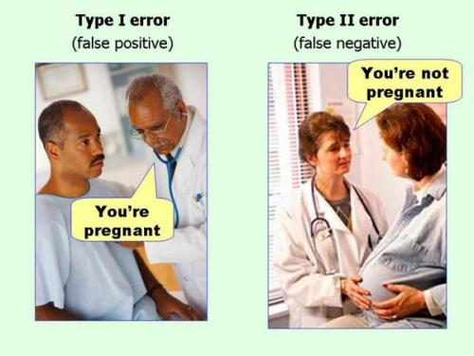
ROC curve, false negative and true positive
Measurements for accuracy of a predictor

Slide 24
Predictions results and how to interpret them?
What are the cutoffs?
How accurate is the prediction score?

Slide 25
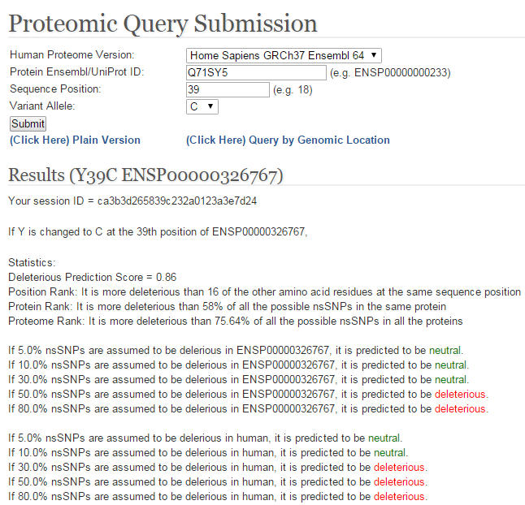
SNPdryad Result
What is this score?

Slide 26
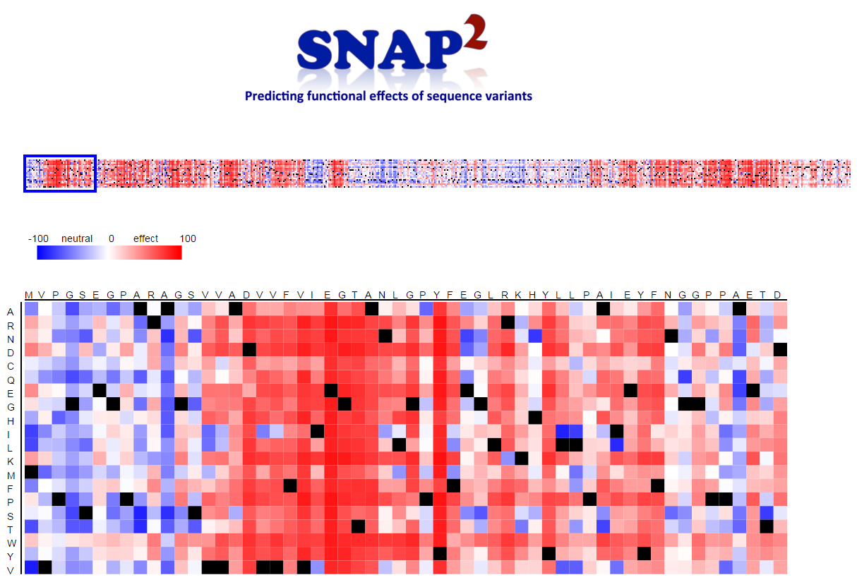
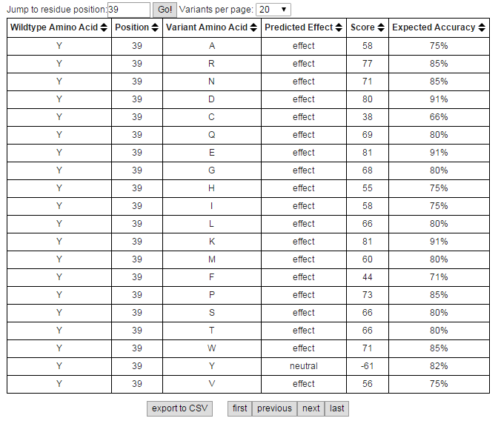
SNAP2 Result
What is this score?
What does “expected accuracy” mean??
Heatmap view
Table view
SNAP2 predicts (each substitution independently) and shows every possible substitution at each position of a protein in a heatmap representation. Dark red indicates a high score (score>50, strong signal for effect), white indicates weak signals (-50<score<50), and blue a low score (score<-50, strong signal for neutral/no effect. Black marks the wildtype residues.
Notes:
SNAP2 predicts (each substitution independently) and shows every possible substitution at each position of a protein in a heatmap representation. Dark red indicates a high score (score>50, strong signal for effect), white indicates weak signals (-50<score<50), and blue a low score (score<-50, strong signal for neutral/no effect. Black marks the wildtype residues.

Slide 27
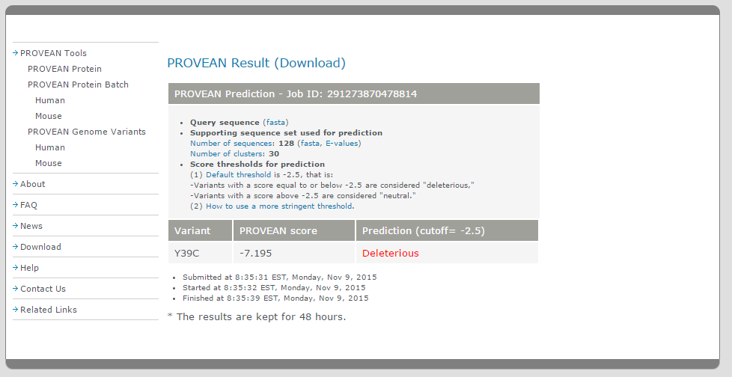
PROVEAN Result
How stringent is this cutoff?
Score thresholds for prediction Default threshold is -2.5, that is:
-Variants with a score equal to or below -2.5 are considered "deleterious,"
-Variants with a score above -2.5 are considered "neutral."
Notes:
Score thresholds for prediction
(1) Default threshold is -2.5, that is:
-Variants with a score equal to or below -2.5 are considered "deleterious,"
-Variants with a score above -2.5 are considered "neutral."

Slide 28
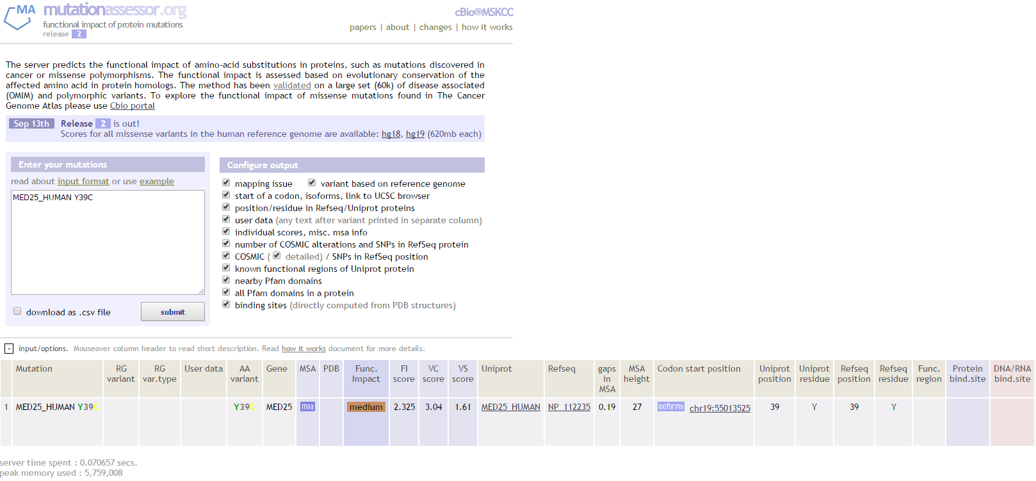
MutationAssessor Result
What is “Func. Impact”?
The functional impact score (FIS) is derived from multiple sequence alignments of sequence homologs. The score is based on the evolutionary conservation of a mutated residue in a protein family and, separately, in each of its subfamilies. Larger scores indicate more likely functional impact of a mutation.
Notes:
The functional impact score (FIS) is derived from multiple sequence alignments of sequence homologs. The score is based on the evolutionary conservation of a mutated residue in a protein family and, separately, in each of its subfamilies. Larger scores indicate more likely functional impact of a mutation.

Slide 29
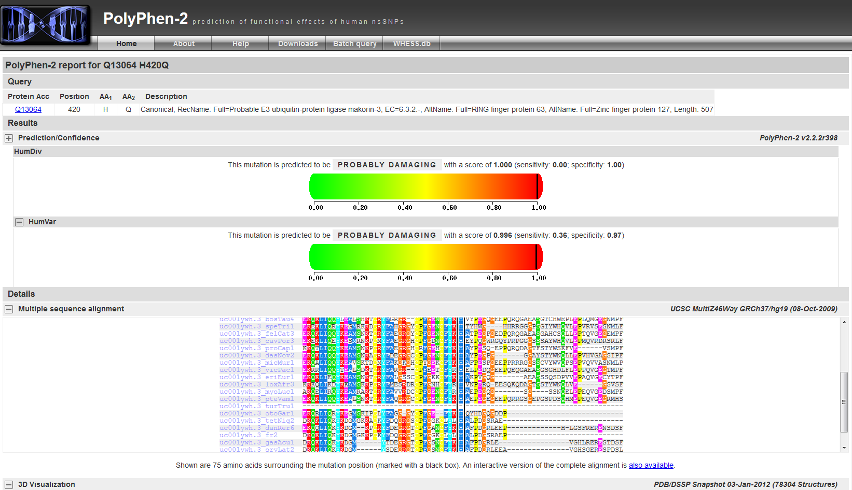
PolyPhen-2 Result
What is this score?

Slide 30
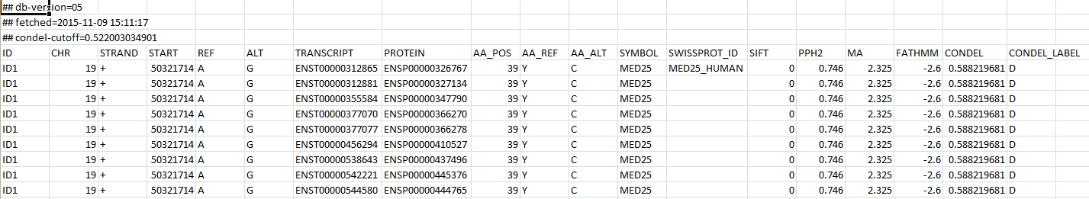
Condel Result
PolyPhen2
SIFT
Mutation Assessor
Condel combined score
Condel label (D)
Empty values in SIFT/PPH2/MA columns indicate mutations whose consequence types are not prone to affect the sequence of the protein product .
0.0 = Neutral, 1.0 = Deleterious.
Notes:
Empty values in SIFT/PPH2/MA columns indicate mutations whose consequence types are not prone to affect the sequence of the protein product .
0.0 = Neutral, 1.0 = Deleterious.

Slide 31
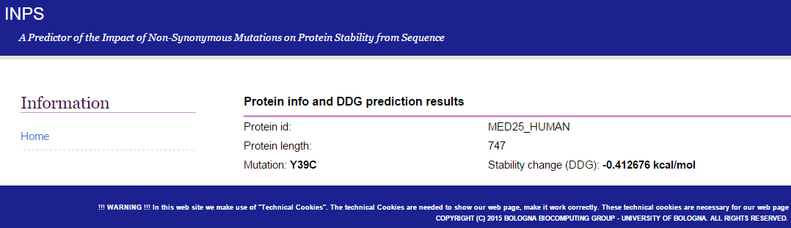
INPS Result
What is this score?

Slide 32
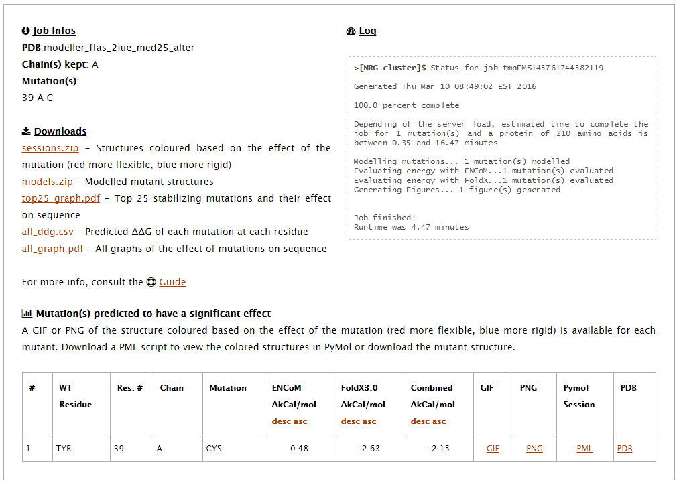
ENCoM Result
Make sure the PDB has chain!
What is this score?
Ddg below 0.5 kcal/mol stabilizing. And ddg higher than 0.5 kcal/mol destabilizes the protein.
Combined score is linear combination of the predictions by vibrational entropy based ENCoM calculations and the enthalpy-based FoldX3.0 beta
Notes:
Ddg below 0.5 kcal/mol stabilizing. And ddg higher than 0.5 kcal/mol destabilizes the protein.
Combined score is linear combination of the predictions by vibrational entropy based ENCoM calculations and the enthalpy-based FoldX3.0 beta

Slide 33
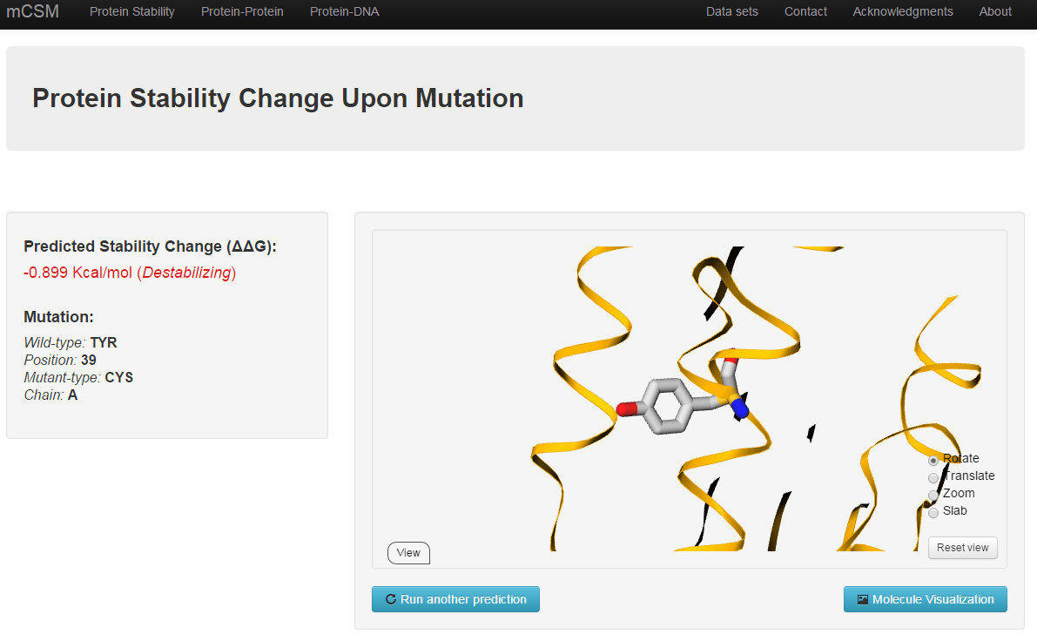
mCSM Result
What is this score?

Slide 34
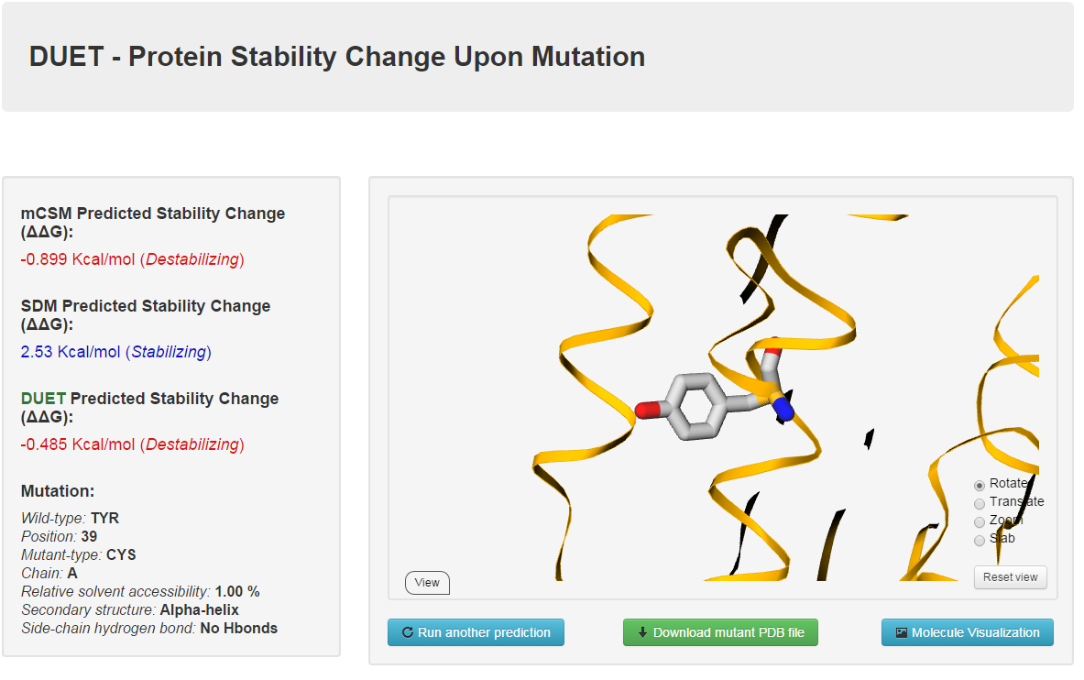
DUET Result
What is this score?

Slide 35
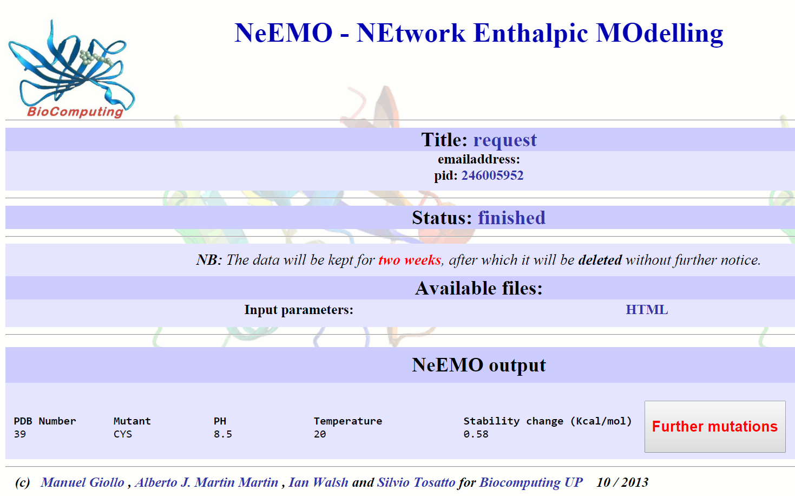
NeEMO Result
What is this score?
The difference between wild type and mutant polypeptide energy (ΔΔG = ΔGwt - ΔGmut) is a measure of how the amino acid change affects protein stability.
Notes:
The difference between wild type and mutant polypeptide energy (ΔΔG = ΔGwt - ΔGmut) is a measure of how the amino acid change affects protein stability.

Slide 36
Summary
We learned to use different prediction tools.
Combination of results…
What else can we do to verify the importance of a position to the structure/function?
conservation
electrostatics
hydrophobicity
Secondary structure
Solvent accessibility
Post- translational modifications

Slide 37
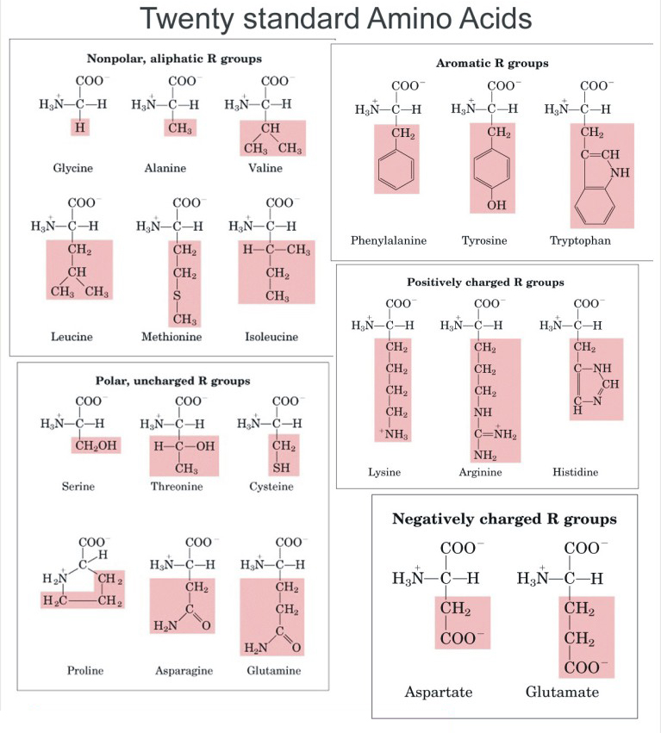
Other tools to learn about a protein
Uniprot
Search for homologs & build your own alignment
ConSurf- conservation analysis
Look at changes in hydrophobicity, polarity, charge, size of amino acid
Secondary structure prediction

Slide 38
Get more involved in the analysis
Collect Homologs yourself
Sequence Alignment
Secondary structure prediction
3D structure prediction
Mutation surrounding
Conservation Analysis
Hydrophobicity profile
Electrostatics profile
Solvent Accessibility
Will the mutation destroy a beta-strand or alpha-helix?
Conservation of physico-chemical properties
3D Structure Analysis
Protein Family
Sequence Motifs
Other known mutations

Slide 39
MED25 published results
Presenting a 102 sequences MSA in a single line using a sequence logo of the 75 first amino acids of MED25.
Position 39 is highly conserved.
Homozygous MED25 Mutation Implicated in Eye-Intellectual Disability Syndrome.
Lina Basel-Vanagaite et. al. Human Genetics, March 2015.

Slide 40
MED25 published results
Tyrosine 39 is a highly conserved position in MED25.
It is part of a hydrophobic core of the VWA Domain.
VWA domain colored by conservation
colored by hydrophobicity
Homozygous MED25 Mutation Implicated in Eye-Intellectual Disability Syndrome.
Lina Basel-Vanagaite et. al. Human Genetics, March 2015.

Slide 41
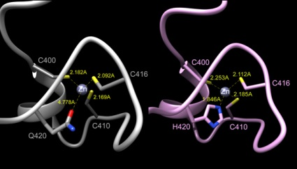
Another example- MKRN3 H420Q
Sequence based methods
SNPdryad
PROVEAN
Structure based methods
mCSM
DUET
Mutation Assessor
PolyPhen-2
INPS
ENCoM
NeEMO
SDM
Condel
mutant
WT
A novel MKRN3 missense mutation causing familial precocious puberty.
de Vries L, Gat-Yablonski G, Dror N, Singer A, Phillip M. Hum Reprod. 2014

Slide 42

Thank you for participating!
Adva Yeheskel
03-6406840
suezadva@tauex.tau.ac.il
Sherman building- Room 001- TAU

